Slide 1
Information about Noise Calculator v3.0 Updated December 2017
Classification: Open 2016-02-22

Slide 2
Content
General
Button assignments
Information is shown on the results page
About the calculated noise – Results
Printout of exposure calculations
Field measurements with the equipment running
% of work time with button pressed
Background noise
Working time in hours, minutes or %
Information about some categories
About hearing protection
Hearing protection: Conditions for higher attenuation values
The main changes to the previous version
When the use of noisy equipment also causes exposure to vibration
Contact the occupational hygienist
Classification: Internal 2012-05-04

Slide 3
1. General
The Noise calculator is based on documented detailed risk assessments of relevant noisy works tasks (methodology is given in GL0169 “Noise control in operation“).
Noise exposure can be calculated for:
  Work in noisy areas
  For noisy work operations
  Combination of work in noisy areas and noisy work operations.
The Noise Calculator is applicable to both to 8 and 12 hour working days.
Content
Classification: Internal 2012-05-04

Slide 4





2. Button assignments
Add a new work task by clicking
  A work task/ work in areas with noise is chosen by double clicking or marking the item and clicking
  Put in the necessary information, or edit the information and click
Work tasks can be edited by clicking or deleted by clicking
Several work tasks and noisy work operations can be chosen for the same day.
Content
Classification: Internal 2012-01-09

Slide 5
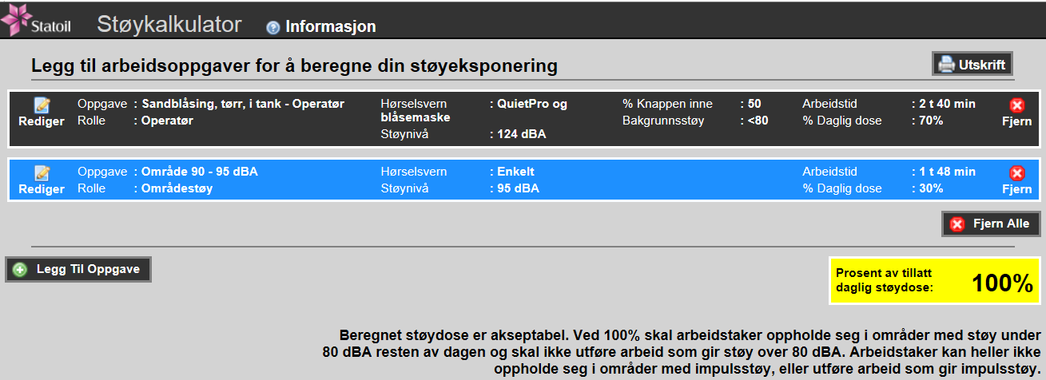
3. Information shown on the results page
Required hearing protection for each work activity
How large percentage of the time is the noisy equipment running (“button pressed”)
Total permitted work time with this noise exposure is 4 h 28 min
How long a period can the activity be carried out over and how large a percentage of the acceptable daily noise dose is used up.
Calculated noise dose for the sum of the work activities.
Info text. Variable dependent on the calculated total noise dose for the noisy task
Content
Classification: Internal 2012-05-04

Slide 6
4. About the calculated noise - Results
Result 0-50% - Calculated noise dose is acceptable.
Result 50-99% - Calculated noise dose is acceptable, consider measures to reduce noise dose.
Result 100% - Calculated noise dose is acceptable. At 100% personnel shall only work in surroundings with noise levels below 80 dBA for the rest of the day. Personnel can not be in surroundings with impulse noise for the rest of the day.
Result 101% to 199% – Calculated noise exposure is not acceptable and the work cannot be executed as planned. Reduce the noise level and/or exposure duration.
Result 200% or more – Calculated noise exposure is not acceptable and the work cannot be executed as planned. Reduce the noise level and/or exposure duration. If the work is already carried out it should be reported to the company doctor as a “Danger of Work Related Injury”.
Content
Classification: Internal 2012-05-04

Slide 7

5. Printout of exposure calculations
Printouts from evaluations in pdf format are available both when planning an activity, as documentation for exposure after work has been carried out, and as documentation of the risk of a work related illness developing.
A pdf-report can be produced for either printout or storage. Click
General information can be input to the comment field such as:
  Installation
  Personnel group
  Date
  Comment (space is limited in this field)
Content
Classification: Internal 2012-05-04

Slide 8
6. Field measurements with the equipment running
How to perform field measurements is described in GL0169.
Field measurements should be carried out if the noise levels are likely to be the significantly different to those givenas default value in the Noise calculator, e.g. in a highly reverberant area.
If the field measurement with the equipment running (“button pressed”) show lower or higher levels than those given as default values, the measured value can be added in the Noise calculator.
The Noise Calculator will correct where necessary for acceptable work duration based on the input data.
When verifying field noise measurements are carried out, “Measured” will appear behind the measured value on the results page.
Content
Classification: Internal 2012-05-04

Slide 9
7. % of work time with button pressed
The value shown is the percentage of a typical work cycle where the operator is exposed to noise from the equipment.
A typical work cycle includes preparation and clearing up at the work place, use of the equipment (work time with button pressed) and moving locally between application areas, that is noise and short quieter pauses between.
Longer pauses such as those for meals and coffee breaks, where the operators vacate the work place, are not part of the work cycle.
If the likely usage is going to be either more or less during the work operation then the value shall be entered. Typically if an operation has been well organized before start, the trigger time % is then greater than the default.
The Noise Calculator will make corrections on allowable work time based on the new input value.
Content
Classification: Internal 2012-05-04

Slide 10
8. Background noise
Background noise is the noise level in the area where the operation is to be performed without the equipment for the operation running. The default value is set at < 80dBA so that it does not affect the noise dose.
For background levels above 80 dBA that affect the noise dose, field measurements without the equipment for the operation running or the noise levels from the noise maps shall be applied (use the highest area noise level).
The Noise Calculator will correct where necessary for acceptable work duration based on the input data.
Content
Classification: Internal 2012-05-04

Slide 11
9. Working time in hours, minutes or as a %
«Work time» for a noisy work operation is the total work for the whole work operation.
  E.g. If grinding is performed for 2 hours with the equipment in use approx. 50% of the time, and the area the work is performed in has 88 dBA background noise → The input is 2 hours work time for grinding and add 88 dBA background noise.
Working time can be input as either hours and minutes or as a %.
  When inputting working time in hours and minutes the % of the noise dose is calculated, and this shall not exceed 100%.
  When inputting the % of the noise dose, the acceptable working time in hours and minutes will be calculated. The remainder of the noise dose can be used on other activities or in noisy areas as long as the total is below 100%.
Content
Classification: Internal 2012-05-04

Slide 12
10. Information about some categories
«Work in areas with noise»: The highest noise level in the chosen category is used for the calculations. This is in line with Statoil’s protection regime and follows the work time restrictions in the noise map.
«Tools used in workshops»: Detailed risk assessments have been carried out for some types of tools only used in workshops, where noise levels are below 80 dBA. These work tasks are not defined as a noisy work operation. Hearing protection is set to «single» to hinder noise exposure for single noise events.
«Helipassenger»: Flying time («Work time») is set to 79 minutes to account for longer or shorter flying time. Shorter flying time does not result in significantly lower exposure as the time spent around the helicopter, particularly offshore, is the dimensioning factor. Required hearing protection for helicopter passengers are ear plugs, even when seated in the helicopter with the door open. Calculated exposure time (“Work time”) is expressed in minutes, not hours and minutes.
“Scaffolding”: A detailed risk assessment of scaffolding (construction, demolition and transportation) is performed, but one has chosen not to include the activity in the noise calculator. The risk assessment showed that scaffolders can work a whole shift without the noise dose reaches 80 dBA when using single ear protection. Of course there are high impulse values / peak levels, but this is attenuated with individual hearing protection. On this basis, the biggest impact on the noise dose for scaffolders will be from the area noise and planning of work is best handled by using noise map or “Work in areas with noise“ in the noise calculator.
Content
Classification: Internal 2012-05-04

Slide 13
11. About hearing protection
For work in noisy areas, permitted work time is calculated based on the following attenuation values: ​
  ​12 dB for single ear protection (earmuffs or earplugs)
  18 dB for double hearing protection (earmuffs and earplugs).
  30 dB for QuietPro
For risk assessed noisy work operations, higher attenuation values are used based on the spectral content of the noise (low, medium or high) and that the conditions for higher attenuation values are fulfilled (see slide 12).
  This gives longer acceptable durations for noisy work than for work in noisy areas with the same noise level.
When using QuietPro, 30dB attenuation is used to calculate permitted work time. If a dose alarm occurs, the noisy work shall be terminated and no work with noise levels exceeding 80 dBA or impulse noise shall be carried out for the rest of that day.
For QuietPro and blast helmet permitted work time is calculated based on 36 dB attenuation.
For earplugs and blast helmet permitted work time is calculated based on 24 dB attenuation.
Content
Classification: Internal 2012-05-04

Slide 14
12. Hearing protection: Conditions for higher attenuation values
The following conditions shall apply when carrying out noisy work operations (ref GL0169):
  Routines with extra focus and knowledge are applied to both use and maintenance of hearing protection.
  The chosen hearing protection shall have sufficiently high attenuation values (product data).
  Hearing protection shall be used 100% of the time in noise zones (>80dBA).
  Hearing protection shall be well maintained (soft and complete ear cushions, sufficient compression force).
  Ear plugs available in several sizes.
  When using universal or individual cast plugs, individual training in use and insertion shall be given. For each individual, verification of achieved attenuations shall show at least 12dB attenuation.
Content
Classification: Internal 2012-05-04

Slide 15
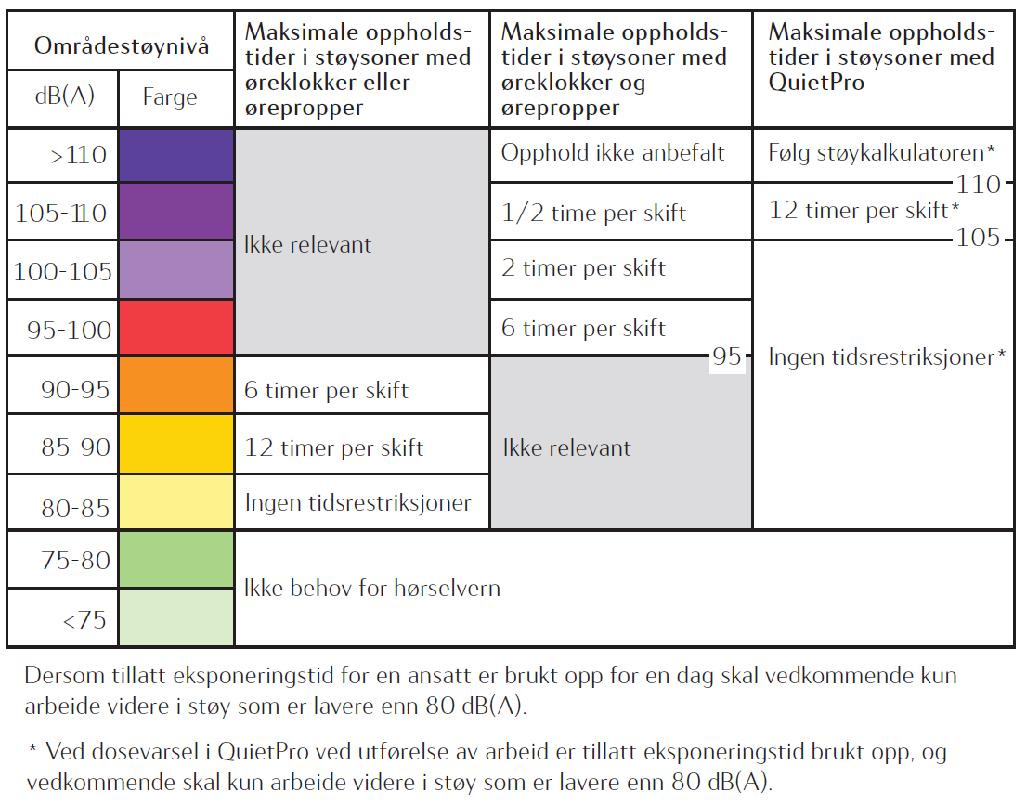
13. The main changes to the previous version
QuietPro for «Work in areas with noise» with work time restrictions as shown in figure:
«QuietPro and blast helmet» and «Earplugs and blast helmet» are included as noise protection for the following work tasks:
  UHT, Sandblasting, Slurry blasting, Sponging
Allowed working time exceeding 16 hours is shown as «No restrictions»
Helicopter type EC225 removed
New work task (January 2018): Helicopter noise exposure for SAR-personnel
Content
Classification: Internal 2012-05-04

Slide 16
14. When the use of noisy equipment also causes exposure to vibration
In the assessment of acceptable work time, when there is both noise and vibration exposure, the exposure that gives the shortest acceptable work time shall be used to make the decision for execution of the work operation.
When several different tools are used through the day, a vibration calculator shall be used to determine the total day’s exposure. Statoil does not have any preference as to which vibration calculator is used.
Internally in Statoil, this vibration calculator can be used (in Norwegian only).
Calculations of the vibration shall comply with the requirements given in TR0926 «Working environment».
When identifying ergonomic challenges ErgoRisk shall be used when evaluating manual work.
Content
Classification: Internal 2012-05-04

Slide 17
15. Contact the occupational hygienist
Contact the occupational hygienist
  when there are questions with the calculations
  when the required work operation is not on the list
  with questions about the attenuation
The occupational hygienist can in cooperation with the HSE coordinator/HSE leader offshore carry out an evaluation of the noise exposure for the work operations that is not in the Noise Calculator.
Content
Classification: Internal 2012-05-04

